Slide 1
Anzen
Garima Gupta | 945-217-0009 | garima.gupta2@utdallas.edu
Karan Desai | 980-319-2650 | karan.desai@utdallas.edu
Manthan Vaghani | 469-468-1671 | manthan.vaghani@utdallas.edu
Mohammed Ayan Khan | 469-924-7029 | mohammedayan.khan@utdallas.edu
Ravikiran Pise | 469-473-1826 | ravikiranramchandra.pise@utdallas.edu
Rushikesh Kumbhar | 469-579-0841 | rushikeshbharat.kumbhar@utdallas.edu

Slide 2

Overview
Problem
Solution
Opportunity & Target Market
Technology
Competition
Projections & Roadmap
Marketing & Sales
Finances
Product Statement
A Blockchain solution to safeguard your payments you pay online using 5G and Edge computing

Slide 3
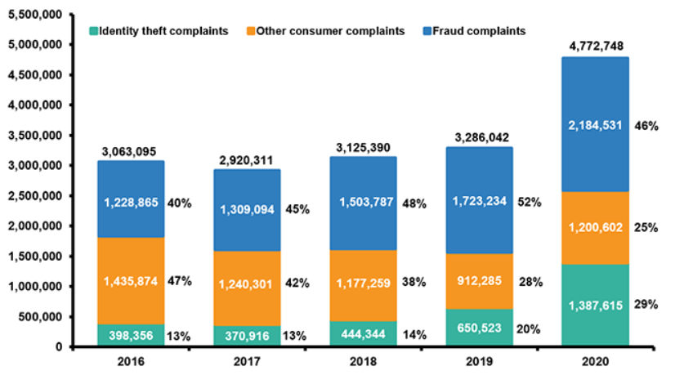
The Problem : Man-in-the-Middle attacks
Accounts 30% of all frauds
Online frauds account 1.8% of total revenue on average
Direct loss due to these attacks is 0.216% of total revenue
Cause losses of $3.6 B annually due to Chargebacks (Fees, legal, investigation, prosecution, lost revenue)
Avg cost as % of revenue: 0.63%, translates to $5.5 Billion annually

Slide 4
Opportunity and Target Market
$5.5 B annual revenue potential
Specifically targeting ecommerce and online retail verticals
Potential to earn $ 400 M YoY even when targeting ~200 customers

Slide 5
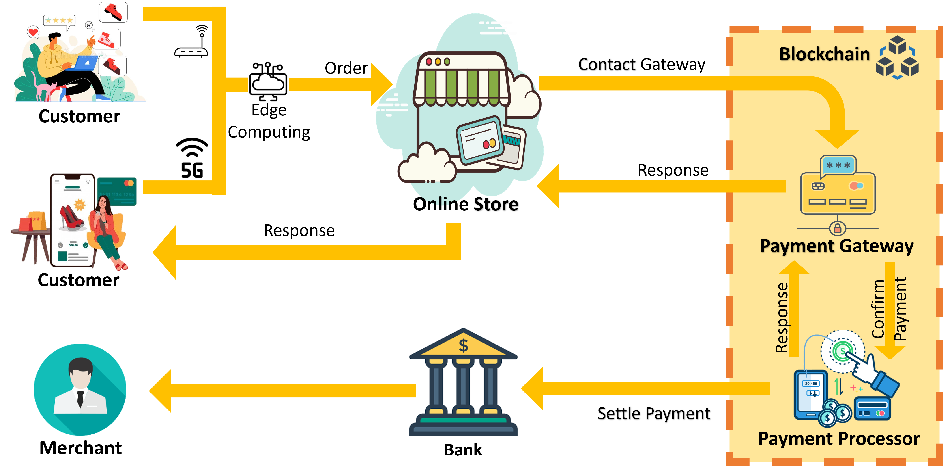

The Solution
Value to customers
Prevent a 0.63% of their revenue annually in the E-commerce industry
Safer payments and checkouts
Reduced reputation losses, customer payouts, and customer churn
Product Uniqueness
Designed for Payments
Enhanced security with Blockchain
Low Latency and high throughput through 5G and Edge Computing
Entry Barriers
Strategic partnerships – AT&T, AWS, Stripe
Aggressive pricing & customer retention strategies
Early moves to acquire the ecommerce giants

Slide 6






Technology & Demo
Partners and Responsibilities
Network and scaling
Networking infra and Edge systems
Blockchain Solution & Deployment
Payment Gateways Integration
Payment Processing
Leveraging 5G and Edge
Using nodes as blockchain network components. These nodes would be authenticators for blockchain
5G to connect to end-users to the payment portals
Edge computing for the higher computational power of these nodes to code and decode blocks
Edge for handling millions of transactions
Deployment and Demo Environments
Deployed and hosted on AWS EC2 – across-US datacenters
Controlled environment like AT&T’s Foundry simulating a moderated payment hijacking attempt on a Prod-like platform blocked by the solution
Technology Considerations
AWS EC2 – 6 nodes across 3 regions in the US
Edge Nodes – 20 nodes across Population centers
AWS S3 – 10 TB of storage

Slide 7
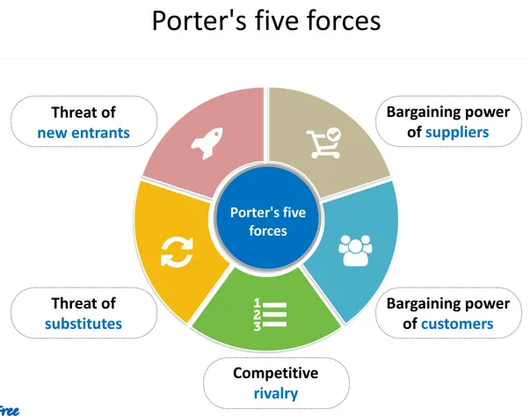
SWOT Analysis & Porter’s Five Forces Analysis
Security of Blockchain
Specifically Designed for Payments
Low Latency and high throughput
Integrity of Partners
Hiring the right talent
Churn
S
W
Medium
High
O
T
Wider 5G and Edge customer-base
Market entry into newer markets through strategic partnerships & innovation
Regulatory uncertainty
Multi-party collaboration
High R&D costs
Customization of the offering
Low
Low
Medium
Notes:
Suppliers involved are Infrastructure providers and technology partners and because of high transaction volumes, the bargaining power is considered high
Customers doesn’t have an array of options and hence this factor is considered Low
There are few companies that are providing payment security but itand hence threat remains High
Availability of substitutes remains low as this is an intermediate layer of security between
Gaming industry has evolved to be a place of high competition and direct rivals like EA, Ubisoft, SONY, and Nintendo have made the classification to be High

Slide 8
Competition
Payplaza
Anzen
Advantages
Only company enhanced with 5G, Edge and Blockchain.
Focused only on Digital Payments services.
Wider future scope to expand into different types of security services
Vantiv
iControl
Google Pay
Stripe
Paypal
Verizon - Palo Alto
Trustwave
CA Technologies

Slide 9
Marketing & Sales Strategy
Marketing Cycle
Sales Channel
AT&T Marketplace
In-house Sales Team
Channel Partners
Sales and Customer Acquisition Funnel
Customer & Competitive Intelligence
Marketing & Sales qualified leads
{ 0.5 month} | 400 customers
Pricing Strategy
Intent / Opportunity
{0.5 month} | 225 customers
Networking Events
First Customers
Customers with niche market. E.g. InkBox, Blue Apron, FEDEX, AT&T, Mint Mobile
Buyer Persona
Stakeholder Mapping
{1 month} | 125 customers
SEO, Content Marketing
POC/ Pilot
{2-3 months} | 75 customers
Bronze | < 1 M | 0.3%
Commercial Negotiation
{1-2 months} | 35 customers
Silver | 1 M to 10M | $ 500K
Gold | 10M to 50M | $ 1M
LOI/ Legal Review
{1-3 months} | 16 customers
Diamond | 50M to 100M | $ 5M
Platinum | 100M to 500M | $ 10M
Deal Won
6 customers
Palladium | >500M | $ 15M

Slide 10
Business Model & Revenue Model
 | YEAR 1 (in $M) |  |  |  | YEAR 2 (in $M) |  |  |  | YEAR 3 (in $M) | YEAR 4 (in $M) | YEAR 5 (in $M)
 | QTR 1 | QTR 2 | QTR 3 | QTR 4 | QTR 1 | QTR 2 | QTR 3 | QTR 4 | YEAR 3 | YEAR 4 | YEAR 5
REVENUE FROM CUSTOMERS
<1 million | - | - | - | 0.3 | 0.3 | 0.3 | 0.3 | 0.3 | 0.9 | 0.72 | 0.6
1 million to 10 million | - | - | - | 0.5 | 1 | 2 | 2.5 | 2.5 | 7.5 | 6.5 | 5
10 million to 50 million | - | - | - | - | 1 | 2 | 2 | 4 | 10 | 12 | 12
50 million to 100 million | - | - | - | - | - | - | 5 | 5 | 35 | 40 | 40
100 million to 500 million | - | - | - | - | - | - | 10 | 10 | 30 | 40 | 50
>500 million | - | - | - | - | - | - | - | - | 15 | 15 | 15
TOTAL REVENUE BY NEW CUSTOMER | - | - | - | 0.8 | 2.3 | 4.3 | 19.8 | 21.8 | 98.4 | 114.22 | 122.6
RETENTION REVENUE(OLD CUSTOMER) | - | - | - | - | - | - | - | 19.04 | 28.6 | 88.9 | 142.4
NET REVENUE (A) | - | - | - | 0.8 M | 2.3 M | 4.3 M | 19.8 M | 40.9 M | 127 M | 203.1 M | 265 M
 | Year 1 (in $M) | Year 2 (in $M) | Year 3 (in $M) | Year 4 (in $M) | Year 5 (in $M) | Total (in $M)
COGS
INFRASTRUCTURE | 22.3 | 24.4 | 31.77 | 31.77 | 31.77 | 142.01
TOTAL DEVELOPMENT COST
Development | 1.93 | 4.83 | 6.53 | 7.68 | 8.02 | 27.54
Legal | 0.13 | 0.29 | 0.36 | 0.36 | 0.36 | 1.49
Client Support | 0.12 | 0.48 | 0.72 | 1.08 | 1.08 | 3.48
MARKETING COST (SG&A)
Marketing and Business Development | 1.12 | 3.24 | 1.49 | 1.54 | 1.54 | 8.93
Component | Cost per annum | 5 year Cost (in $M)
AWS EC2 | 0.463 | 2.315
AWS S3 | 0.2 | 1
AWS Blockchain | 0.774 | 3.87
Testing |  | 0.5
Infra scaling fund |  | 10
Edge Infrastructure | 2.4 | 142.01
Human Capital Cost |  | 36.209
Total Cost |  | 194.894

Slide 11
Financial Projections I
Income Statement
[USD $ millions] | YEAR 1 |  |  |  | YEAR 2 |  |  |  | YEAR 3 | YEAR 4 | YEAR 5
 | QTR 1 | QTR 2 | QTR 3 | QTR 4 | QTR 1 | QTR 2 | QTR 3 | QTR 4 | YEAR 3 | YEAR 4 | YEAR 5
REVENUE FROM CUSTOMERS
<1 million | - | - | - | 0.3 | 0.3 | 0.3 | 0.3 | 0.3 | 0.9 | 0.72 | 0.6
1 million to 10 million | - | - | - | 0.5 | 1 | 2 | 2.5 | 2.5 | 7.5 | 6.5 | 5
10 million to 50 million | - | - | - | - | 1 | 2 | 2 | 4 | 10 | 12 | 12
50 million to 100 million | - | - | - | - | - | - | 5 | 5 | 35 | 40 | 40
100 million to 500 million | - | - | - | - | - | - | 10 | 10 | 30 | 40 | 50
>500 million | - | - | - | - | - | - | - | - | 15 | 15 | 15
TOTAL REVENUE BY NEW CUSTOMER | - | - | - | 0.8 | 2.3 | 4.3 | 19.8 | 21.8 | 98.4 | 114.22 | 122.6
RETENTION REVENUE(OLD CUSTOMER) | - | - | - | - | - | - | - | 19.04 | 28.6 | 88.9 | 142.4
NET REVENUE (A) | - | - | - | 0.8 M | 2.3 M | 4.3 M | 19.80 M | 40.9 M | 127 M | 203.1 M | 265 M
COGS
INFRASTRUCTURE | 5.40 | 5.40 | 5.40 | 6.10 | 6.10 | 6.10 | 6.10 | 6.10 | 31.77 | 31.77 | 31.77
NET COGS (B) | 5.40 | 5.40 | 5.40 | 6.1 M | 6.1 M | 6.1 M | 6.1 M | 6.1 M | 31.77 M | 31.77 M | 31.77 M
GROSS PROFIT (C = A - B) | - 5.4 M | - 5.4 M | - 5.4 M | - 5.3 M | - 2.5 M | - 1.8 M | 13.7 M | 34.8 M | 95.3 M | 171.33 M | 233.3 M
INDIRECT COST
DEVELOPMENT COST | 0.36 | 0.50 | 0.66 | 0.66 | 1.39 | 1.39 | 1.41 | 1.41 | 7.61 | 9.12 | 9.46
MARKETING (SG&A) | 0.00 | 0.04 | 0.54 | 0.54 | 0.54 | 0.54 | 1.08 | 1.08 | 1.49 | 1.54 | 1.54
TOTAL INDIRECT COST (D) | 0.36 | 0.57 | 0.70 | 0.70 | 1.93 | 1.93 | 2.49 | 2.49 | 9.10 | 10.66 | 11.00
EARNINGS(C-D) | - 5.76 M | - 5.97 M | - 6.1 M | - 6 M | - 4.43 M | - 3.73 M | 11.21 M | 32.31 M | 86.20 M | 161.67 M | 223 M
Cumulative Earning | - | - | - | - | - |  |  | 11.53 M | 97.73 M | 260 M | 483 M
NPV: $265 M
IRR: 239%
ROI: 222%
Break-Even Period

Slide 12
Financing Sought & Overall Timelines
Investment Required
~ USD 150 M of investment over 5 years distributed equally
In return of 15% of equity & 40% YoY profit until USD 150M is recovered by AT&T
 | Year 1 |  |  |  | Year 2 |  |  |  | Year 3 | Year 4 | Year 5
 | 1 | 2 | 3 | 4 | 1 | 2 | 3 | 4
Product Planning and Research
Financial & Hiring
Prototype Development & Testing
Customer & Market Research
Sales & Marketing Activities
Product Development & Testing
Product Deployment
Customization Development
Customer Acquisition Scaling |  |  | ◆
Timeline
Break-Even Analysis
First Customer

Slide 13
Summary
Financial Attractiveness
High percentage of recurring revenue – the client will provide recurring sources of revenue.
Steady and rapid growth in sales during the first 5 years in a clearly defined market niche.
Forecasted breakeven by year 2 with a reasonable degree of certainty.
Loss of any year is targeted to set-off from the profits of subsequent 2 years.
Steady growth of Profit and Revenue over somewhat fixed cost from year to year comparison.
Success Factors
Sustainable and scalable growth over 5 years
No hijacked payments + Regulatory clean slate for customers and AT&T
Financially viable business model with recurring revenue from customers
Multi-party collaboration
Extension to S, M, & L businesses
Scalability of Solution capabilities
Risk Assessment
Customer Retention (High) – The math relies upon the assumption of 70% customer retention YoY
Aggressive Customer Acquisition (High) – The model is dependent on the total acquisition of the customers by the team
Threat from competitors (High)
Challenges
Regulatory uncertainty
Multi-party collaboration
High R&D costs
Customization of the offering
Newer entrants e.g. Verizon + Palo Alto

Slide 14
Thank You ☺

Slide 15
Appendix
*Assumptions: |  | YEAR 1 (Scalable Demo) |  |  |  | YEAR 2 (1st Set of Customers) |  |  |  | YEAR 3 - (Scaling to several customers) | YEAR 4 - (Scaling to several customers) | YEAR 5 - (Scaling to several customers) | Total 5 year cost of each employee type
Employees |  | Q1 | Q2 | Q3 | Q4 | Q1 | Q2 | Q3 | Q4
Developers | Total Employees | 3 | 4 | 6 | 6 | 20 | 20 | 20 | 20 | 30 | 35 | 35 | $ 89,82,000
 | Cost | $ 54,000 | $ 72,000 | $ 1,08,000 | $ 1,08,000 | $ 3,60,000 | $ 3,60,000 | $ 3,60,000 | $ 3,60,000 | $ 21,60,000 | $ 25,20,000 | $ 25,20,000
Product Managers | Total Employees | 1 | 1 | 1 | 1 | 4 | 4 | 4 | 4 | 7 | 9 | 10 | $ 26,04,000
 | Cost | $ 21,000 | $ 21,000 | $ 21,000 | $ 21,000 | $ 84,000 | $ 84,000 | $ 84,000 | $ 84,000 | $ 5,88,000 | $ 7,56,000 | $ 8,40,000
QA Testers | Total Employees | 0 | 2 | 2 | 2 | 6 | 6 | 6 | 6 | 8 | 10 | 10 | $ 21,30,000
 | Cost | $ - | $ 30,000 | $ 30,000 | $ 30,000 | $ 90,000 | $ 90,000 | $ 90,000 | $ 90,000 | $ 4,80,000 | $ 6,00,000 | $ 6,00,000
DevOps | Total Employees | 0 | 2 | 2 | 2 | 6 | 6 | 6 | 6 | 8 | 10 | 10 | $ 21,30,000
 | Cost | $ - | $ 30,000 | $ 30,000 | $ 30,000 | $ 90,000 | $ 90,000 | $ 90,000 | $ 90,000 | $ 4,80,000 | $ 6,00,000 | $ 6,00,000
Business Analysts | Total Employees | 1 | 1 | 1 | 1 | 3 | 3 | 3 | 3 | 4 | 6 | 8 | $ 15,84,000
 | Cost | $ 18,000 | $ 18,000 | $ 18,000 | $ 18,000 | $ 54,000 | $ 54,000 | $ 54,000 | $ 54,000 | $ 2,88,000 | $ 4,32,000 | $ 5,76,000
Client Support | Total Employees | 0 | 0 | 4 | 4 | 8 | 8 | 8 | 8 | 12 | 18 | 18 | $ 34,80,000
 | Cost | $ - | $ - | $ 60,000 | $ 60,000 | $ 1,20,000 | $ 1,20,000 | $ 1,20,000 | $ 1,20,000 | $ 7,20,000 | $ 10,80,000 | $ 10,80,000
Research Scientists | Total Employees | 3 | 4 | 4 | 4 | 4 | 4 | 4 | 4 | 4 | 4 | 4 | $ 39,50,000
 | Cost | $ 1,50,000 | $ 2,00,000 | $ 2,00,000 | $ 2,00,000 | $ 2,00,000 | $ 2,00,000 | $ 2,00,000 | $ 2,00,000 | $ 8,00,000 | $ 8,00,000 | $ 8,00,000
AWS Architect | Total Employees | 1 | 1 | 1 | 1 | 2 | 2 | 2 | 2 | 3 | 4 | 5
 | Cost | $ 45,000 | $ 45,000 | $ 45,000 | $ 45,000 | $ 90,000 | $ 90,000 | $ 90,000 | $ 90,000 | $ 5,40,000 | $ 7,20,000 | $ 9,00,000 | $ 27,00,000
Legal | Total Employees | 1 | 1 | 1 | 4 | 4 | 4 | 4 | 4 | 5 | 5 | 5
 | Cost | $ 18,000 | $ 18,000 | $ 18,000 | $ 72,000 | $ 72,000 | $ 72,000 | $ 72,000 | $ 72,000 | $ 3,60,000 | $ 3,60,000 | $ 3,60,000 | $ 14,94,000
Business Development | Total Employees | 0 | 3 | 3 | 3 | 5 | 5 | 5 | 5 | 7 | 8 | 8
 | Cost | $ - | $ 40,500 | $ 40,500 | $ 40,500 | $ 67,500 | $ 67,500 | $ 67,500 | $ 67,500 | $ 3,78,000 | $ 4,32,000 | $ 4,32,000 | $ 16,33,500
Marketing | Total Employees | 0 | 3 | 3 | 3 | 6 | 6 | 8 | 8 | 9 | 10 | 10
 | Cost | $ - | $ 40,500 | $ 40,500 | $ 40,500 | $ 81,000 | $ 81,000 | $ 1,08,000 | $ 1,08,000 | $ 4,86,000 | $ 5,40,000 | $ 5,40,000 | $ 20,65,500
Hardware Engineer | Total Employees | 1 | 1 | 1 | 1 | 4 | 4 | 4 | 4 | 4 | 4 | 4
 | Cost | $ 13,500 | $ 13,500 | $ 13,500 | $ 13,500 | $ 54,000 | $ 54,000 | $ 54,000 | $ 54,000 | $ 2,16,000 | $ 2,16,000 | $ 2,16,000 | $ 9,18,000
Project Managers | Total Employees |  |  | 2 | 2 | 3 | 3 | 4 | 4 | 5 | 5 | 5
 | Cost | $ - | $ - | $ 42,000 | $ 42,000 | $ 63,000 | $ 63,000 | $ 84,000 | $ 84,000 | $ 4,20,000 | $ 4,20,000 | $ 4,20,000 | $ 16,38,000
Department/BU Head | Total Employees | 1 | 1 | 1 | 1 | 1 | 1 | 1 | 1 | 1 | 1 | 1
 | Cost | $ 45,000 | $ 45,000 | $ 45,000 | $ 45,000 | $ 45,000 | $ 45,000 | $ 45,000 | $ 45,000 | $ 1,80,000 | $ 1,80,000 | $ 1,80,000 | $ 9,00,000
 |  | $ 3,64,500 | $ 5,73,500 | $ 6,51,500 | $ 7,05,500
Total Human Capital Expenditure in 5 years | $ 3,62,09,000 |  |  | Cost to Demo:- | $ 22,95,000

Slide 16
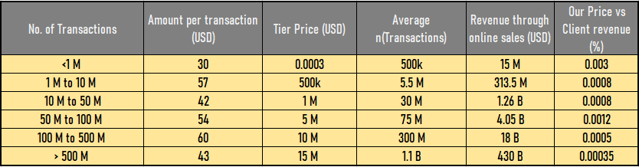
Appendix

